Slide 1
TASTY PLATE
Crave Your Food

Slide 2
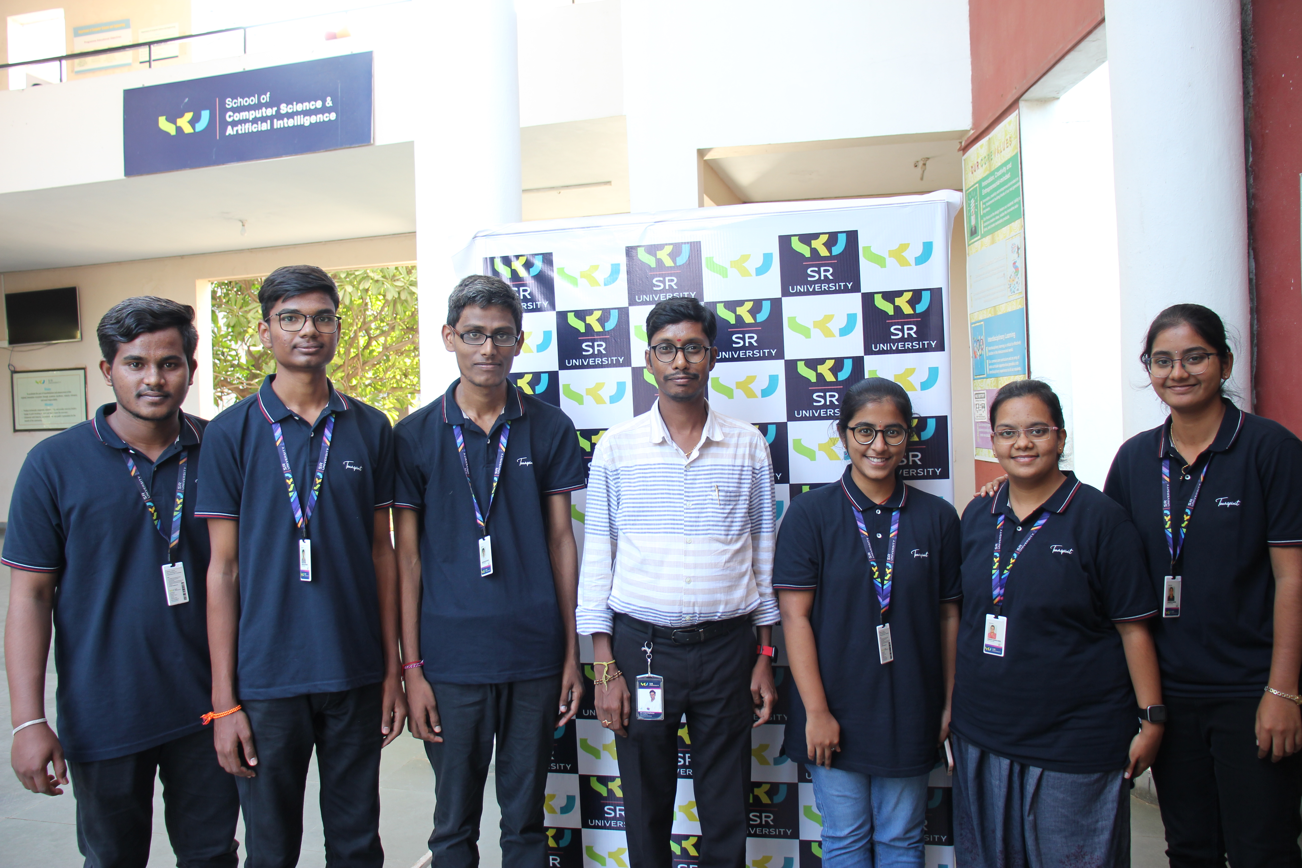
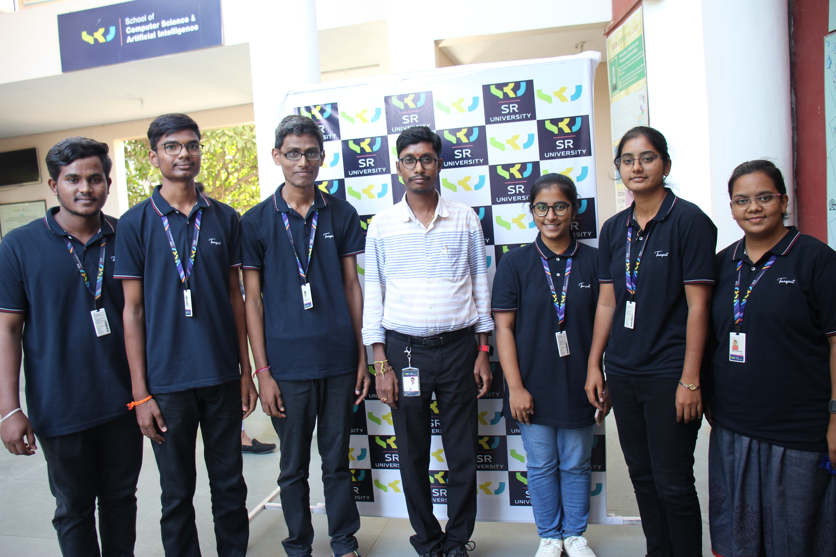
Team Presentation
CH. Keerthika 2103A51394
S. Sahithi Krishna 2103A51428
B. Shiva Krishna 2103A51390

Slide 3
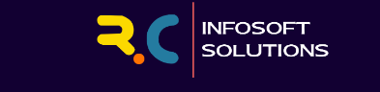
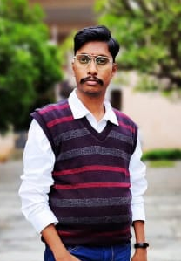
Dr. K. Ravi Chythanya
- Supervisor

Slide 4
Roadmap
Abstract
Proposed System
Architectural Design
1
3
5
Detailed Design
2
4
6
Existing Systems
Requirements Specification

Slide 5
No one is born a great cook, one learns by doing it. Learn how to cook – try new recipes, learn from mistakes, be fearless and above all have fun!

Slide 6

1. Abstract
Cooking is not only a work but also an art. It is not confined to anything it can be learnt by anyone who definitely wants to and that is only possible when you have a right guide to help you learn it.
Welcome to Tasty Plate, our website provides you a platform to learn and cook popular cuisines across all countries. We provide a beginner friendly cooking processes that helps you to learn making your favourite dish.

Slide 7
2. Existing Systems – NDTV Food
New Delhi Television (NDTV) is basically most watched, credible and respected news network in India and a leader in internet.
In order to bring health awareness regarding food, NDTV officially launched NDTV FOOD. This website has introduced many rich features like:
1. Recipes This option allows users to find different kinds of recipes with their preparation and its health information.
2. Nutritionists Speaks This feature allows users to communicate with nutrition experts.

Slide 8
Existing Systems – NDTV Food (cont.)
Disadvantages
Despite providing different kinds of cuisines. This system failed to provide proper guidance in preparing a particular recipe.
Most of the recipes don’t have proper video guidance.
Moreover, the user has to go with searching every time even if he is interested only in one particular country.

Slide 9

2. Existing Systems – Bon Appetit
Bon Appetit is a monthly American food and entertaining magazine, that typically contains recipes, entertaining food tips, and restaurant recommendations.
This website helps food nerds to prepare different kind of cuisines that are popular in USA and Turkey.
Moreover, this website also helps foodies in finding the best restaurants across southern parts of New York.
Disadvantages
Despite having more rich features this website fails in providing video guidance for foodies who are interested in preparing a recipe.
Moreover it is limited to only some cuisines styles confined to only some countries.

Slide 10
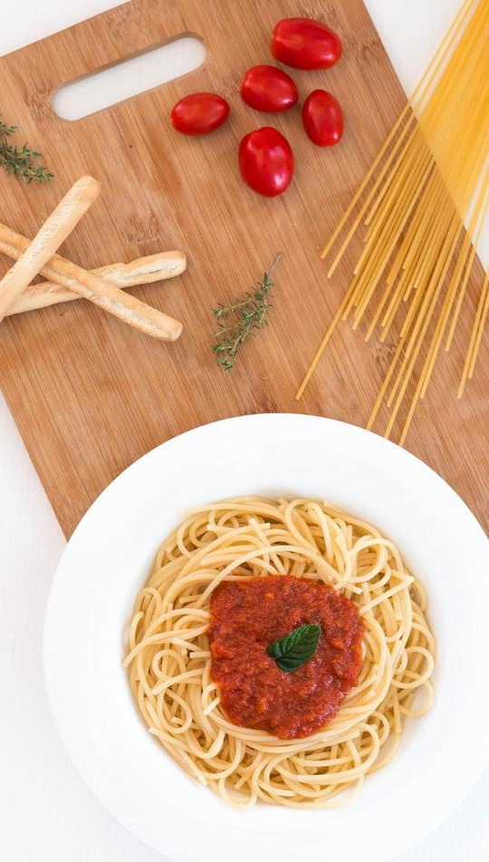
3. Proposed System
Considering disadvantages of existing websites and apps we want to develop a website platform especially for food nerds.
Our website helps foodies to find their favourite local and foreign recipes.
Here they can find different cuisines that are sorted based on different countries so that users interested cooking only particular country cuisines can have easy access.
For each cuisine, they get recipe details, its ingredients, steps involved in cooking it and also an expert video to provide proper guidance.
Moreover we also add nutrition facts of each recipe to make users aware of health facts regarding that recipe.

Slide 11
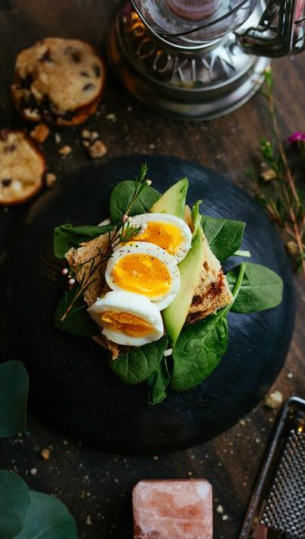
4. Requirements Specification
Stake holders Identification
Primary Stakeholders : Food nerds who are interested in trying to make different recipes in their Kitchen are our primary stake holders.
Secondary Stakeholders : All family persons and people who consumes the recipe prepared falls under secondary stakeholders
Tertiary Stakeholders : The shopkeepers, vendors and meat sellers falls under Tertiary stakeholders as they indirectly get benefit from the primary stakeholders via food items.
Facilitating Stakeholders : We the developers, maintainers of the website and the video content providers fall under facilitating stakeholders as they help us in improving resources in our website.

Slide 12
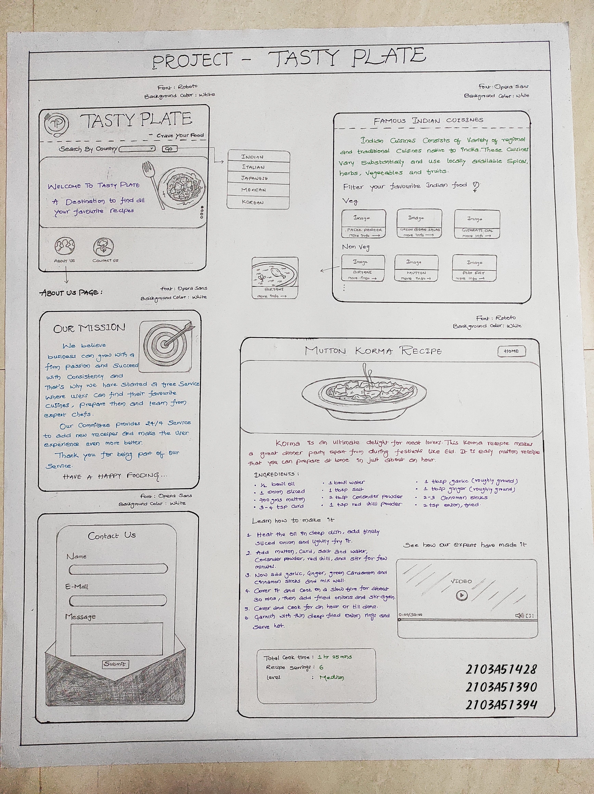
5. Architectural Design

Slide 13
Home Web Page

Slide 14
Country page

Slide 15
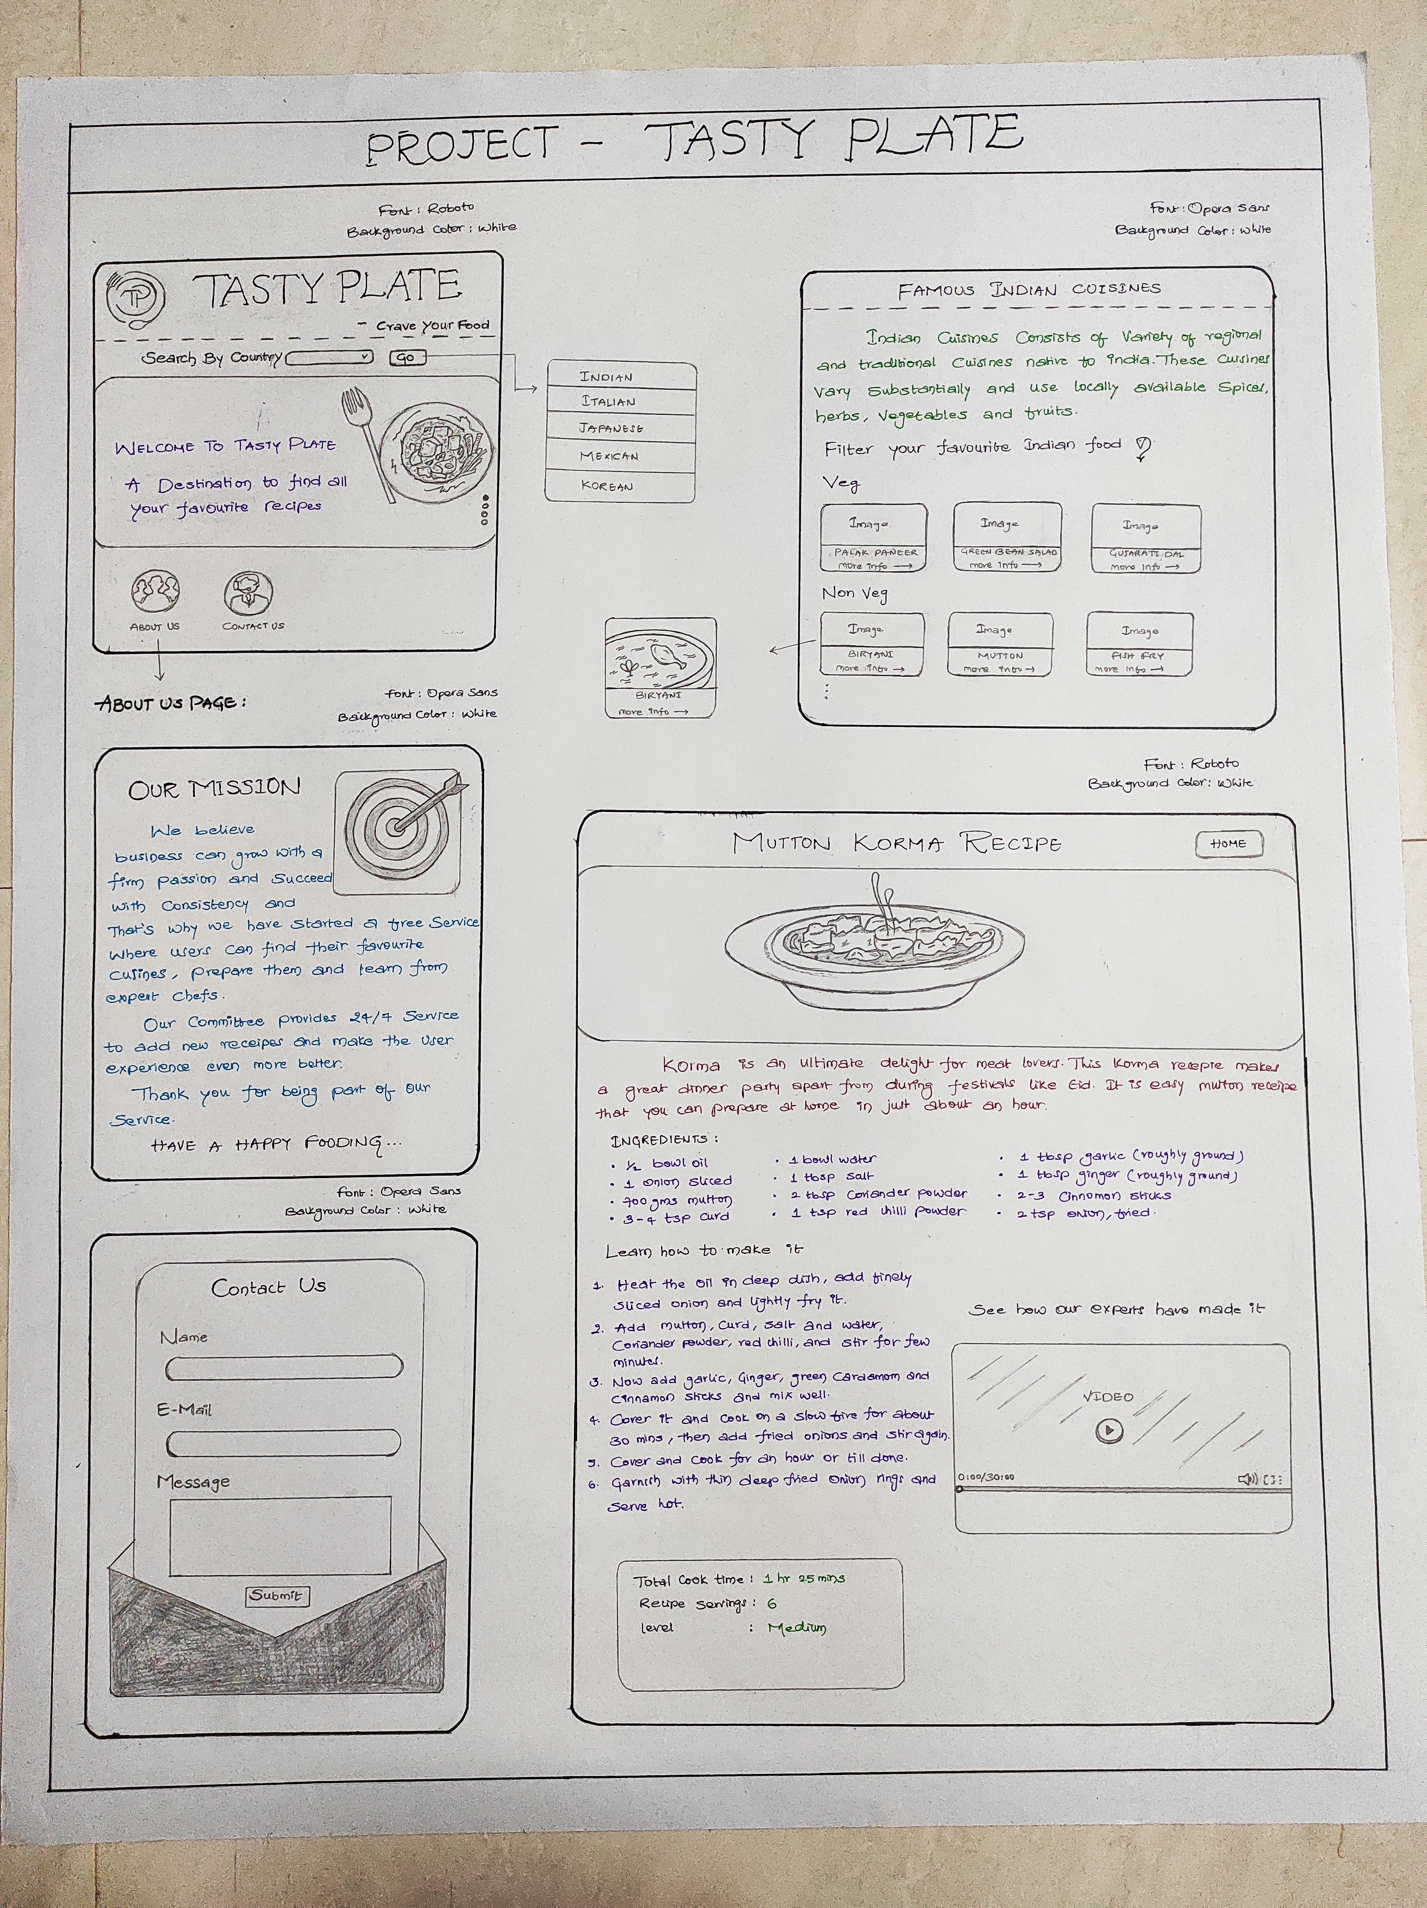
Recipe Page

Slide 16
About us page
Contact us page

Slide 17
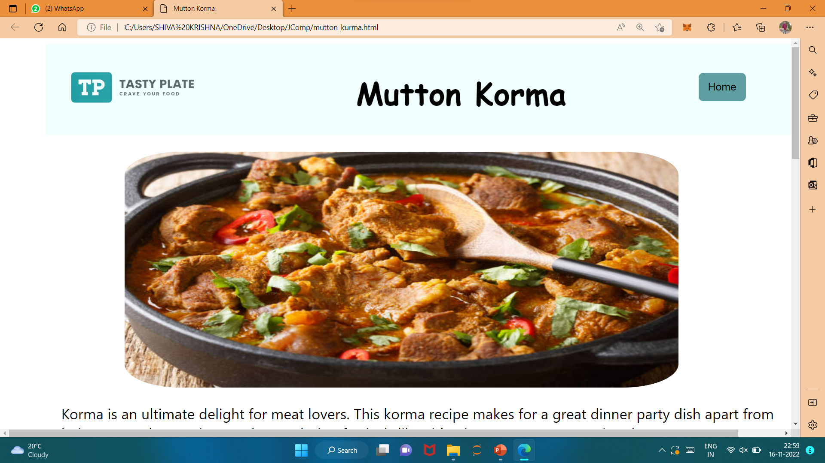
Desktop View

Slide 18
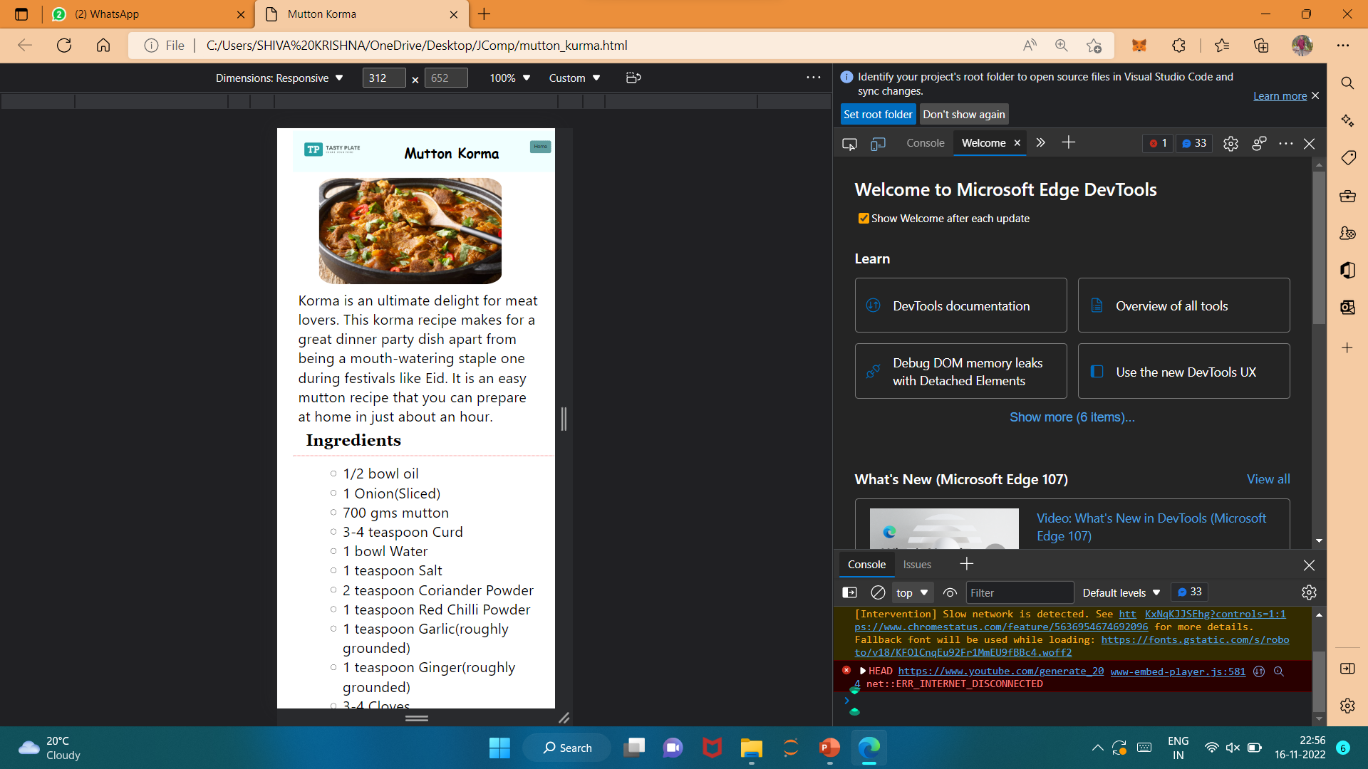
Mobile View

Slide 19
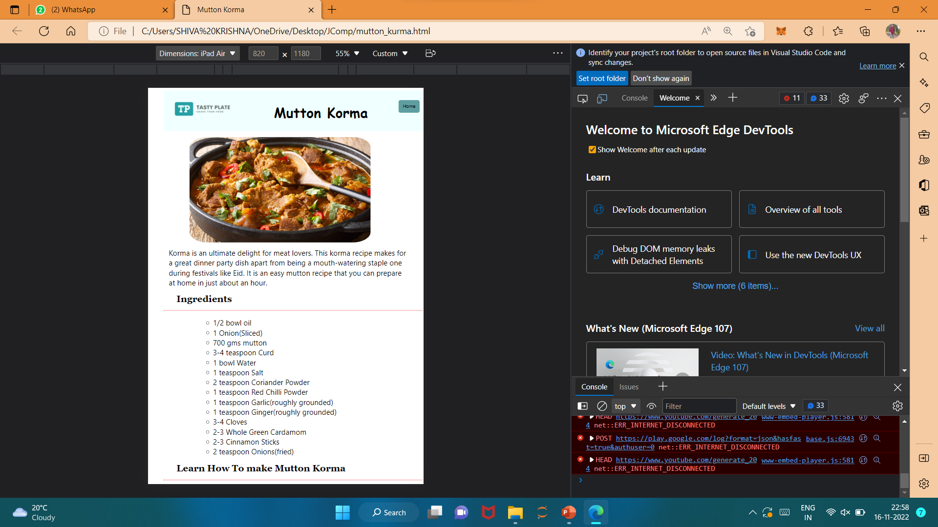
Tablet View

Slide 20
Design Flow
Home Page
Indian
Korean
Veg
Non Veg
Veg
Non Veg
I1
I2
I3
I1
I2
I3
I1
I2
I3
I1
I2
I3

Slide 21
6. Detailed Design

Slide 22
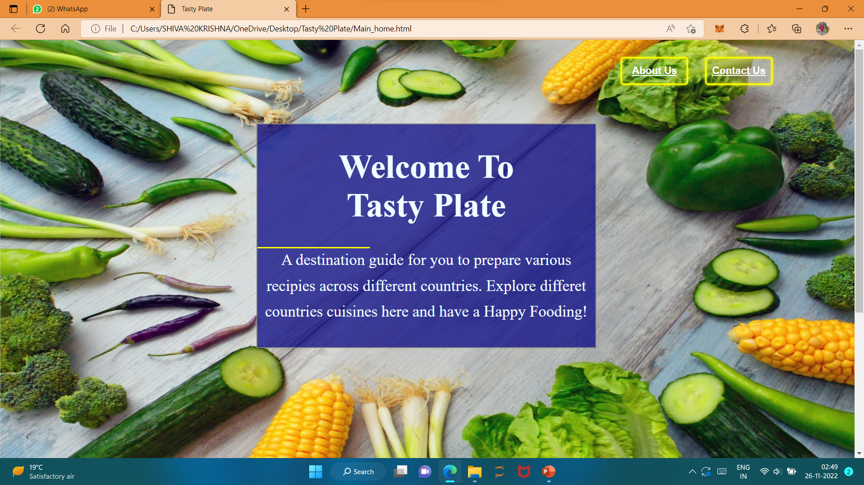
Home Web Page

Slide 23
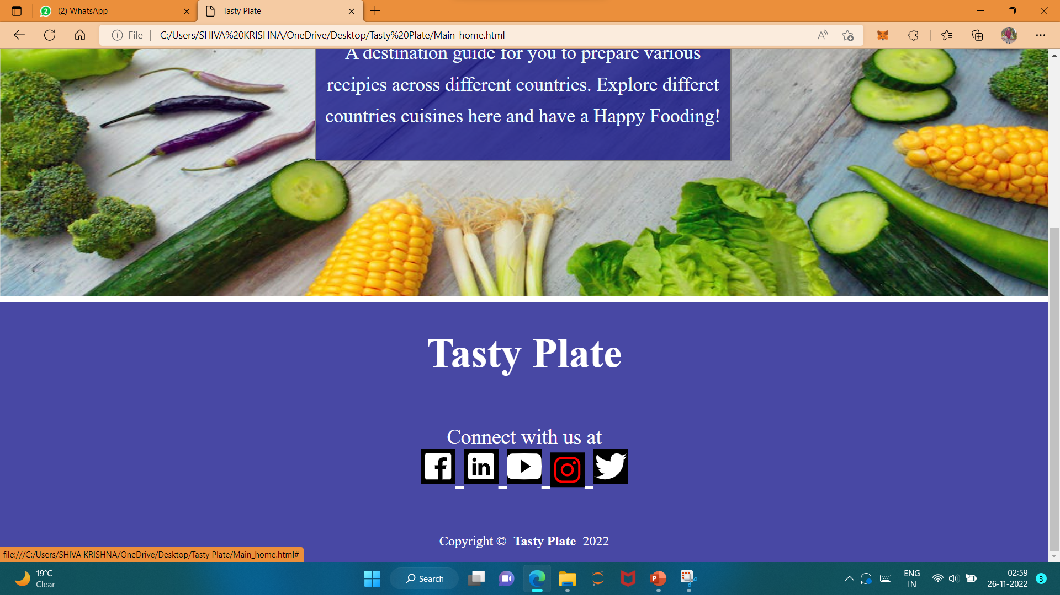
Home Web Page (contd)

Slide 24
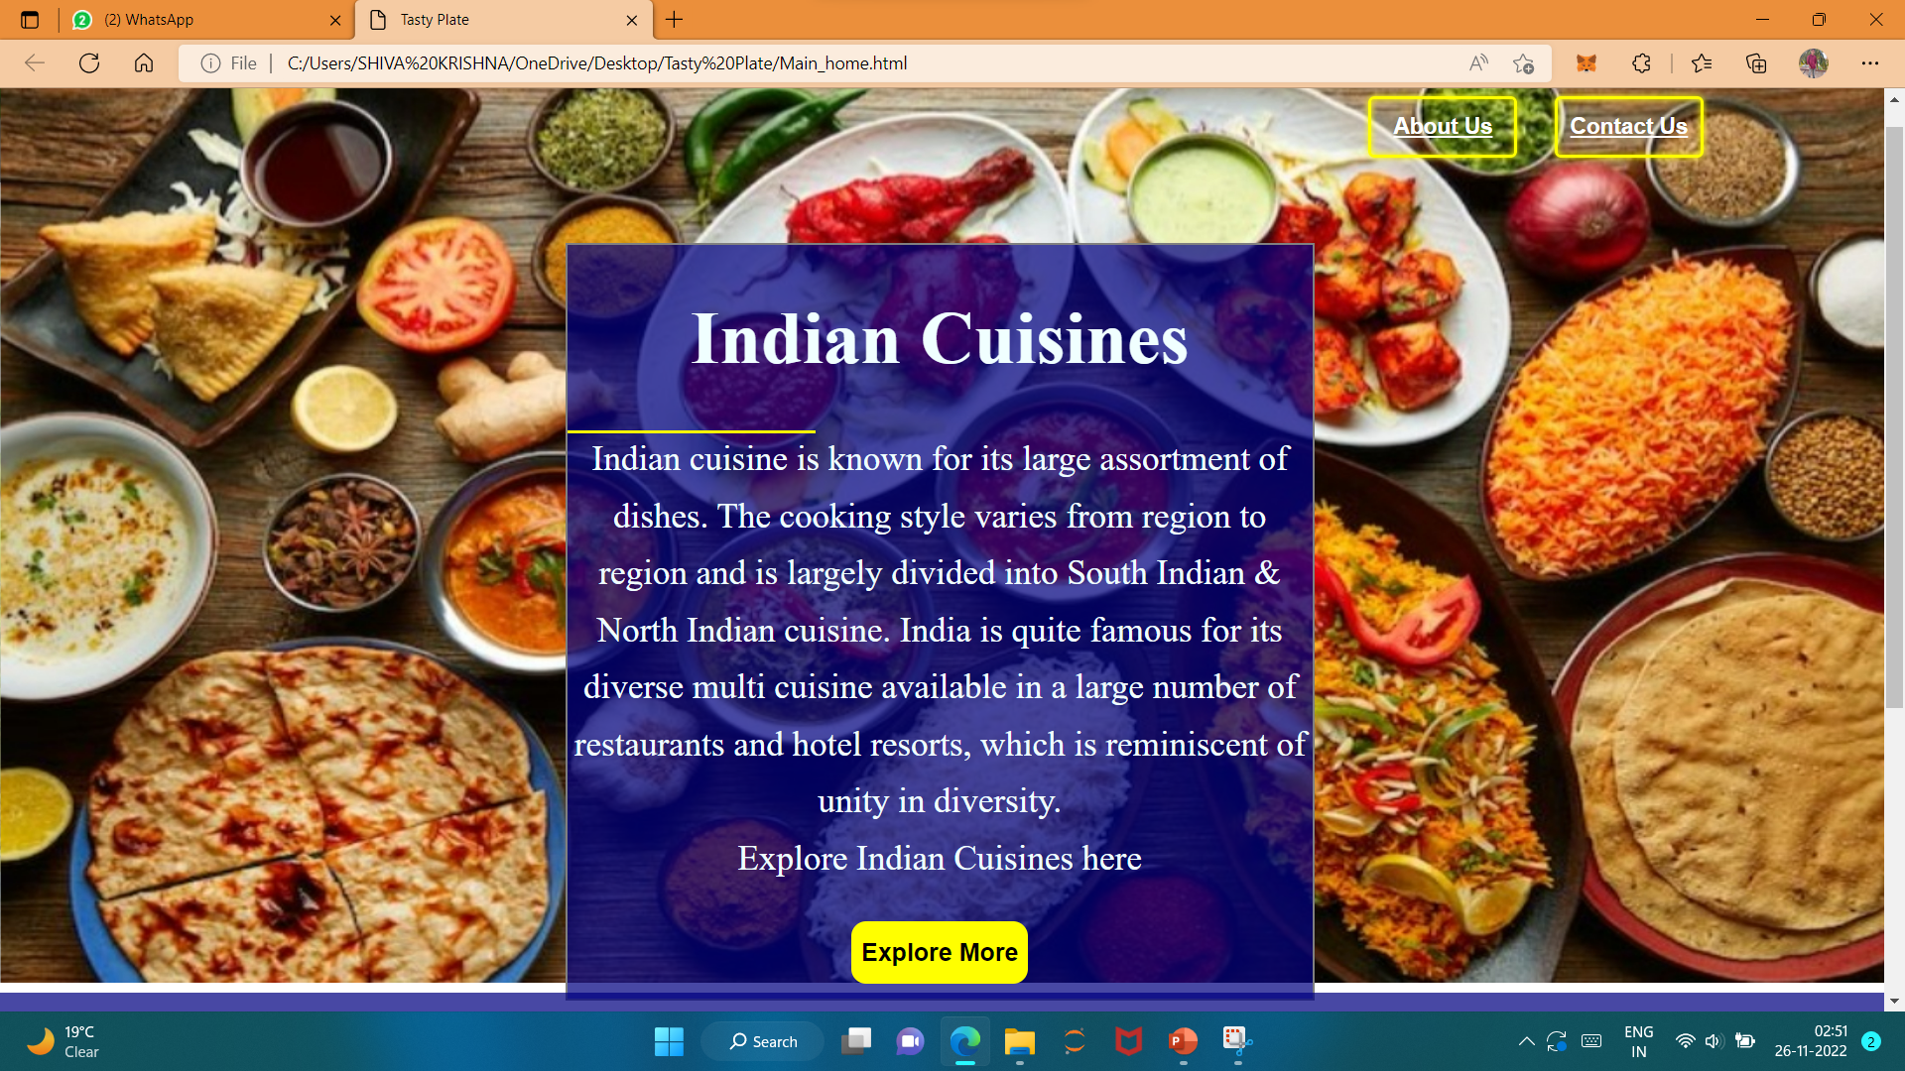
Home Web Page(contd)

Slide 25
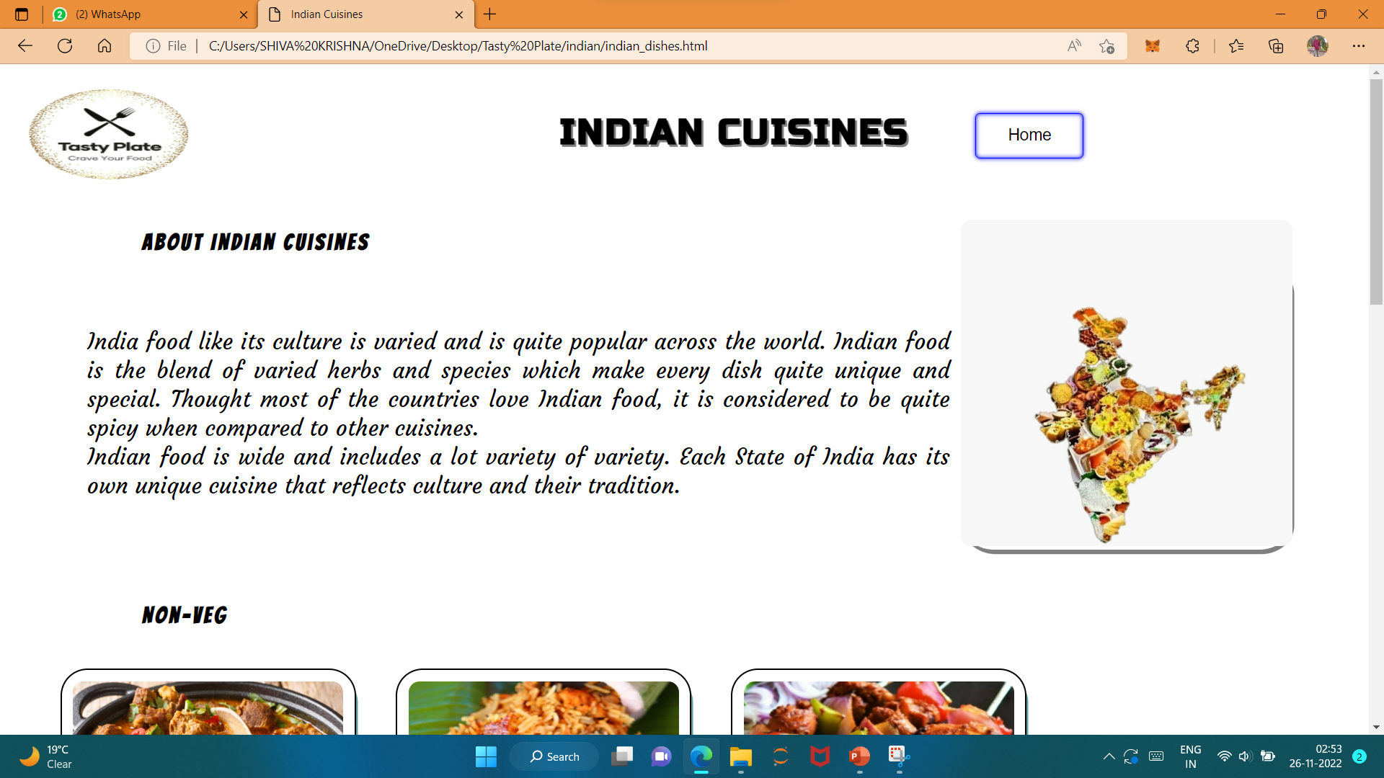
Country Web Page

Slide 26
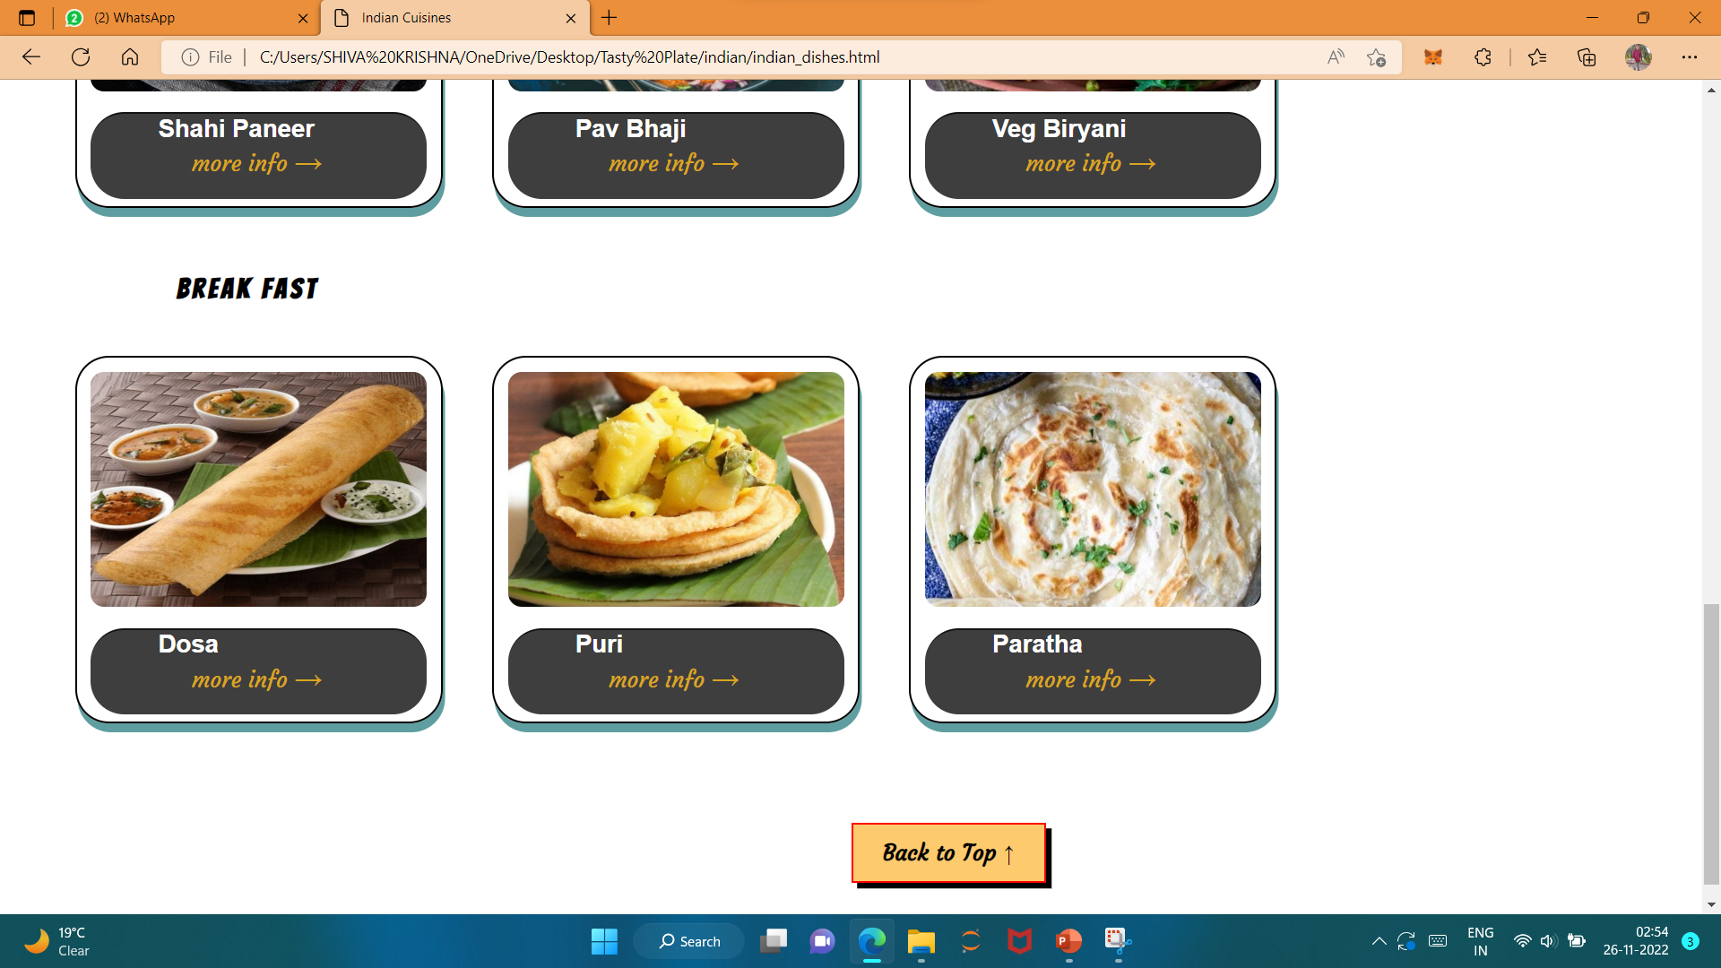
Country Web Page(Contd)

Slide 27
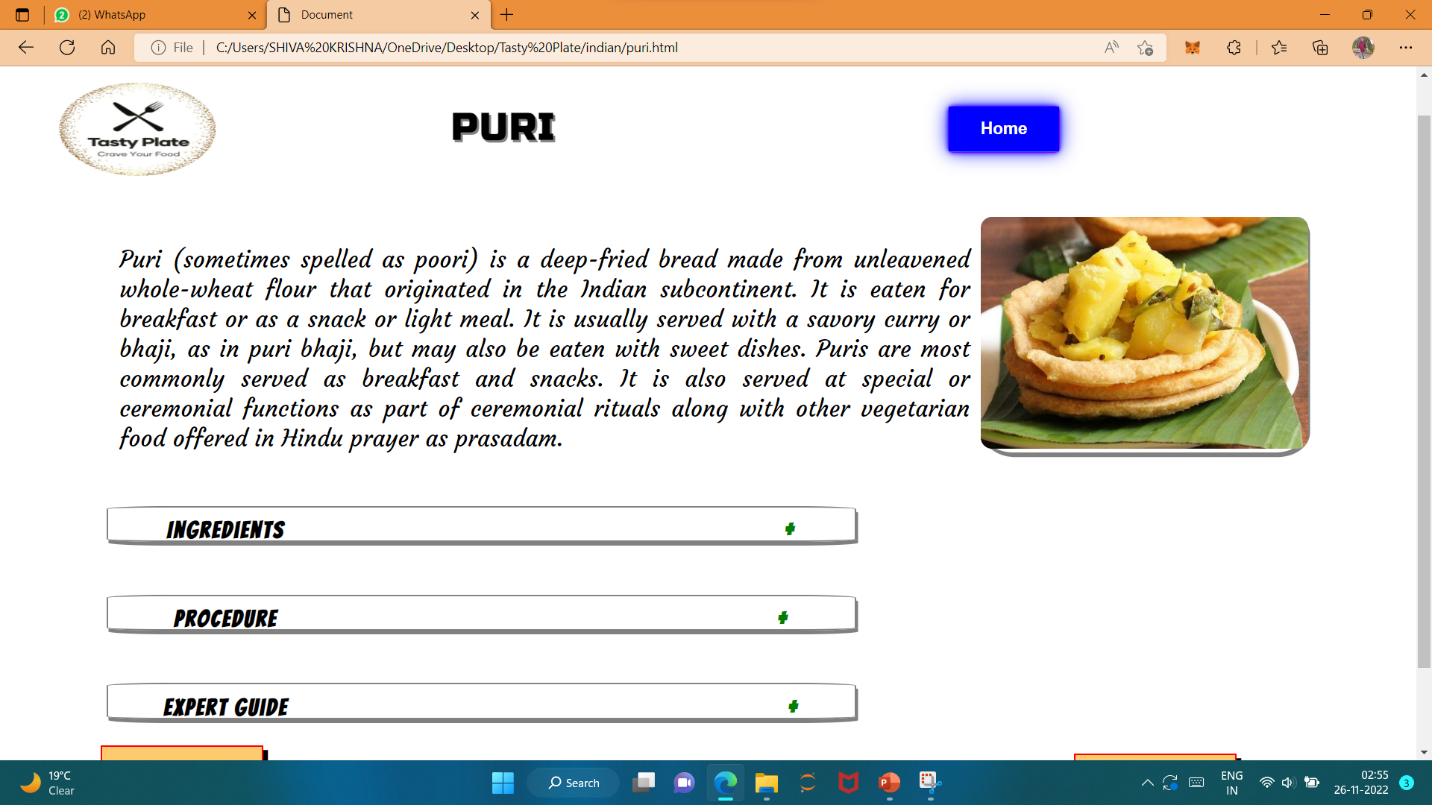
Item Web Page

Slide 28
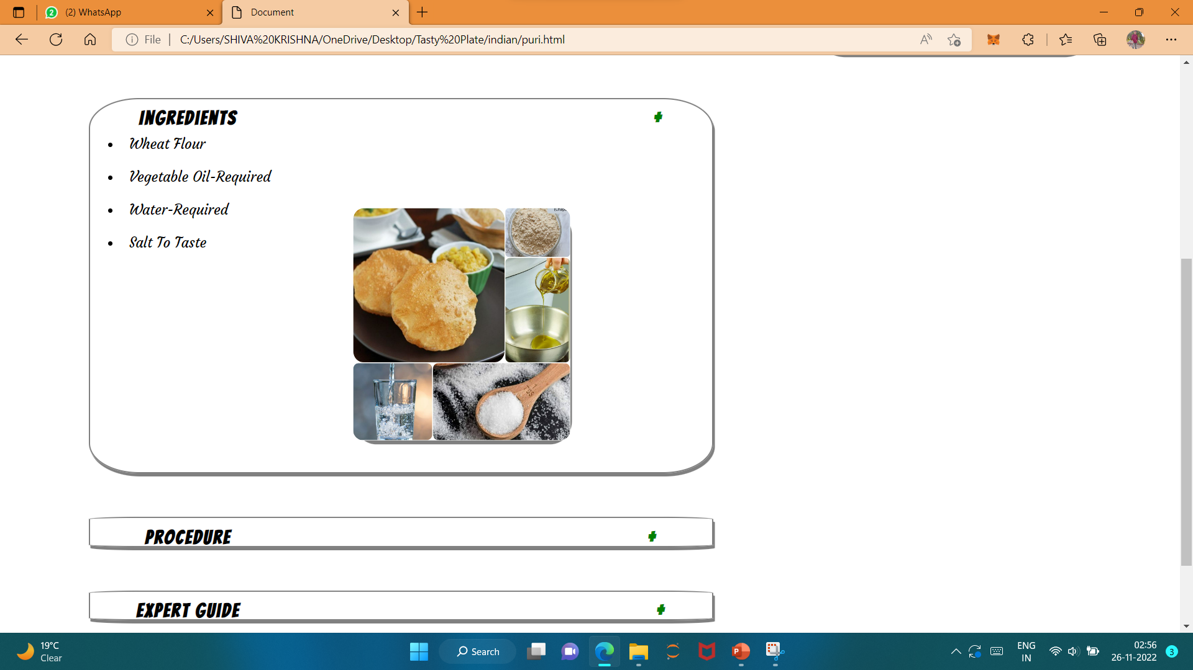
Home Web Page(contd) – Ingredients

Slide 29
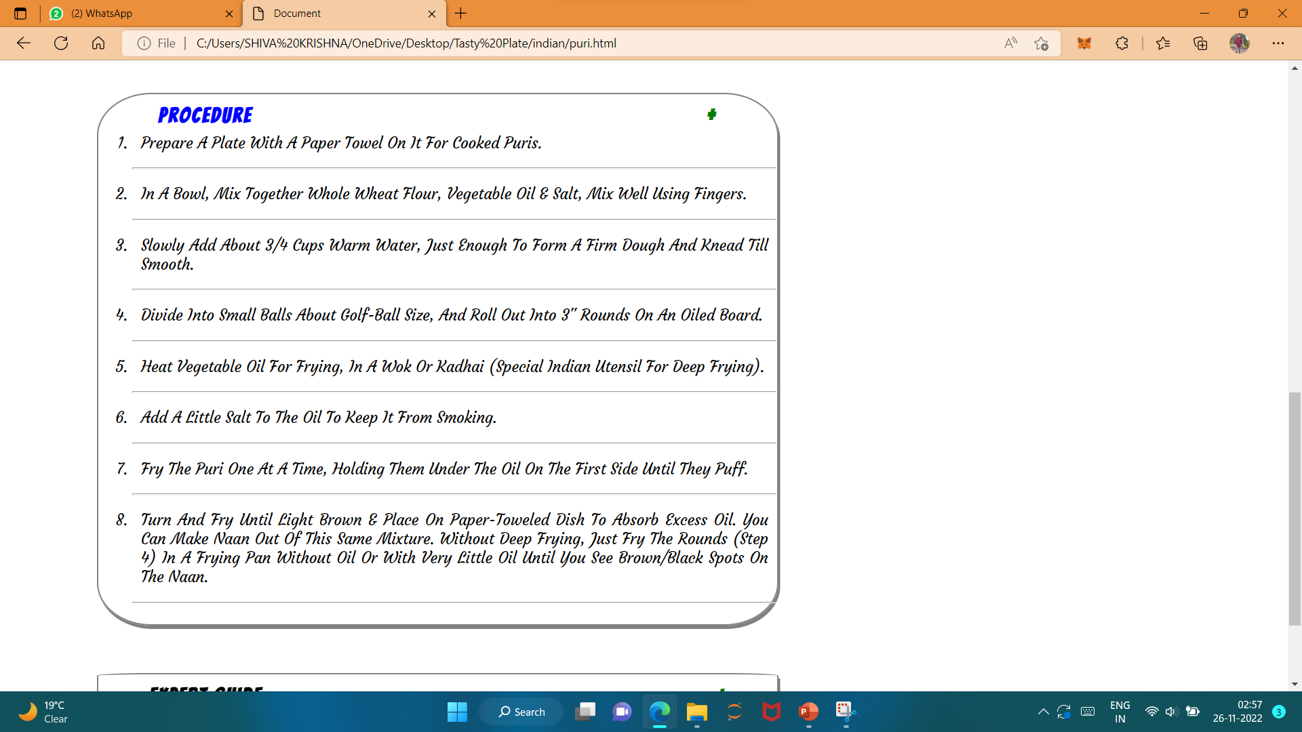
Home Web Page(contd) – Procedure

Slide 30
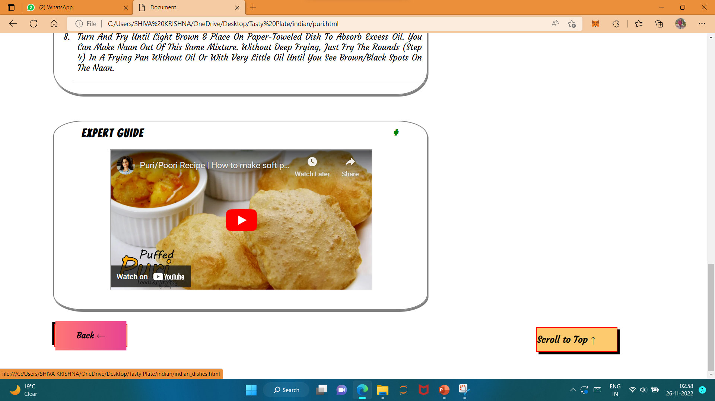
Home Web Page(contd) – Video Guide

Slide 31
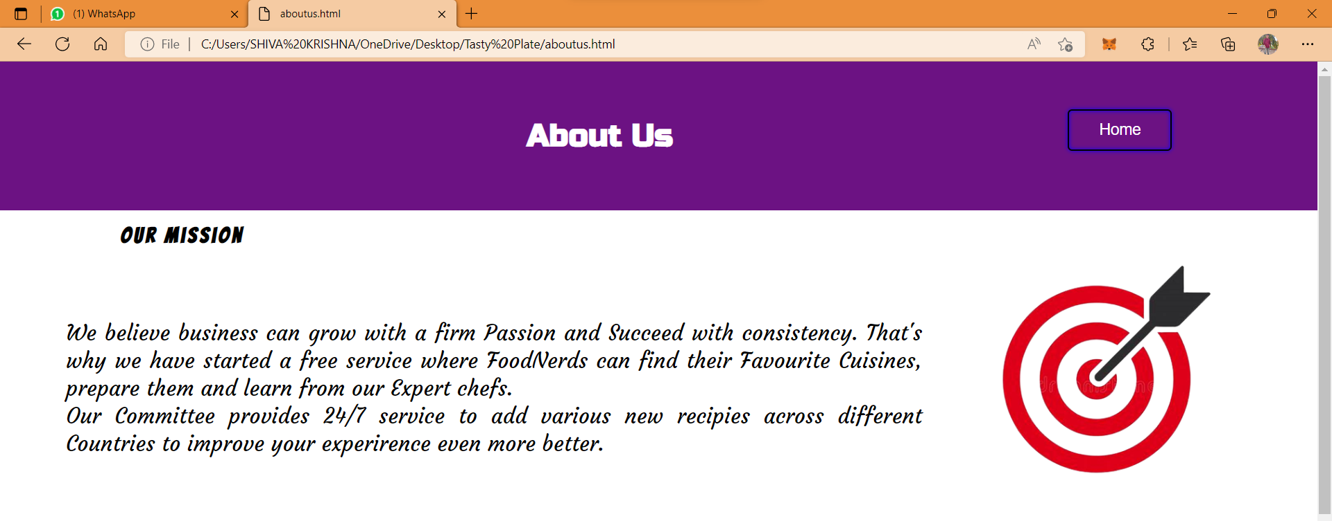
About Us Page

Slide 32
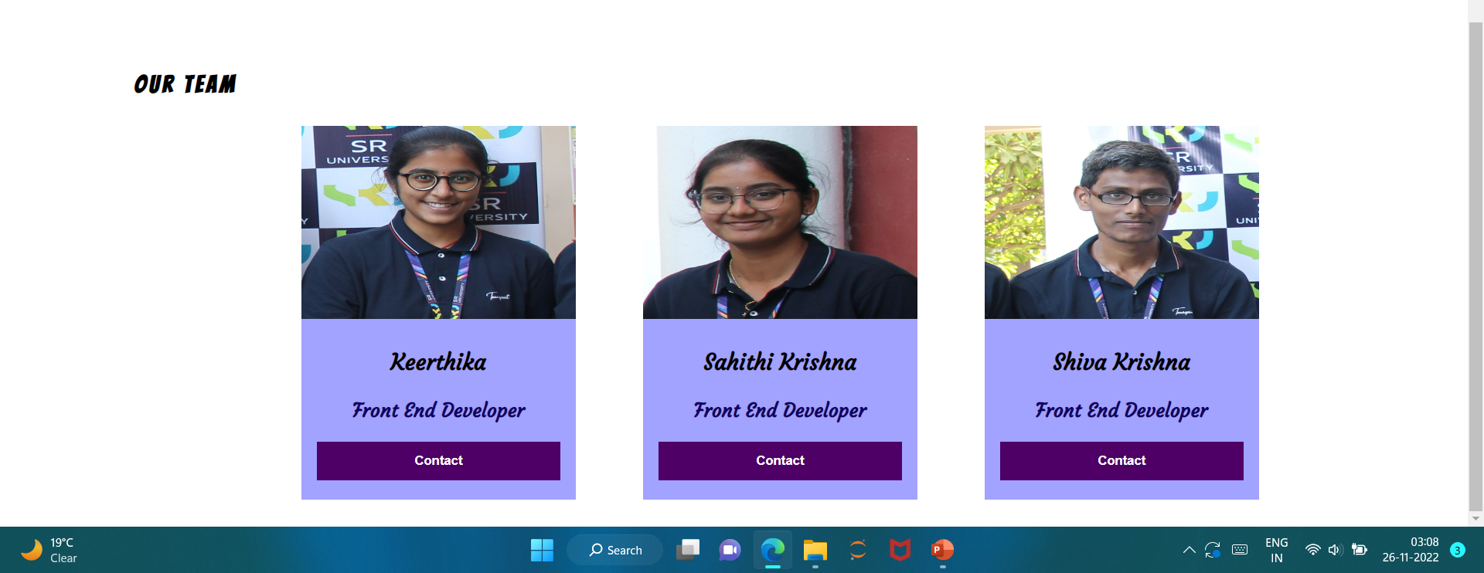
About Us Page

Slide 33
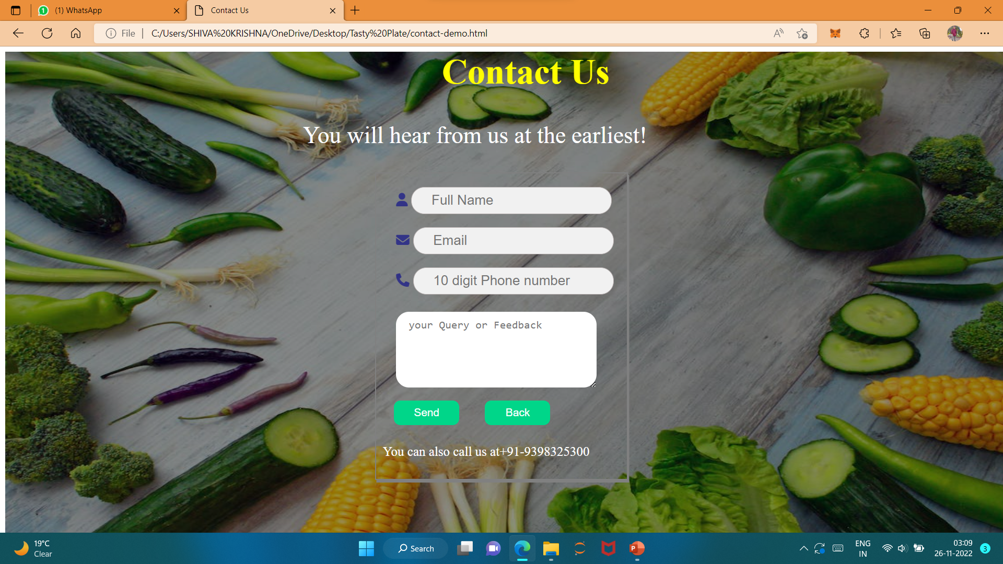
Contact Us Web Page

Slide 34
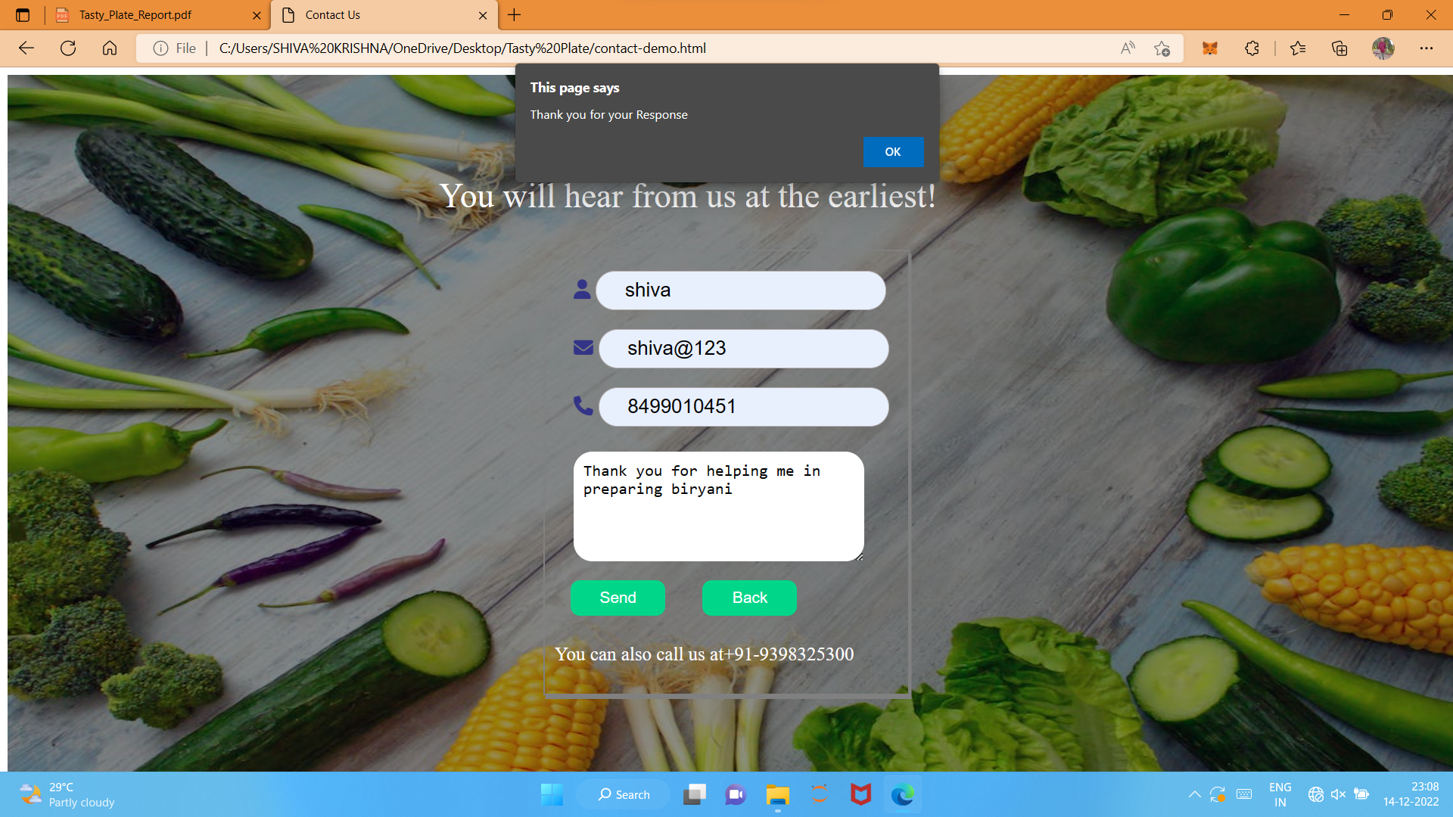
Contact Us Web Page

Slide 35

Thanks!
Any questions?

